Slide 1
DEMO III
Legacy Leavers

Slide 2
Our Team
Elizabeth Howard - Project Manager
Baian Khanjar - Web Developer
Dylan Hampton - UX/UI Designer
Graham Parish - Business Analyst
Brandon Crosier - Database Administrator
Lucas Weaver - Database Designer

Slide 3
Problems We Face
Solutions
>5 clicks to find information/complete tasks
Outdated aesthetically
Many links lead to more links
New layout
Fewer clicks (no more than 2 clicks to find information)
Easier to navigate
More contemporary look to align with the University’s Branding
WordPress CMS
Visio for Wireframing
Link to social media

Slide 4
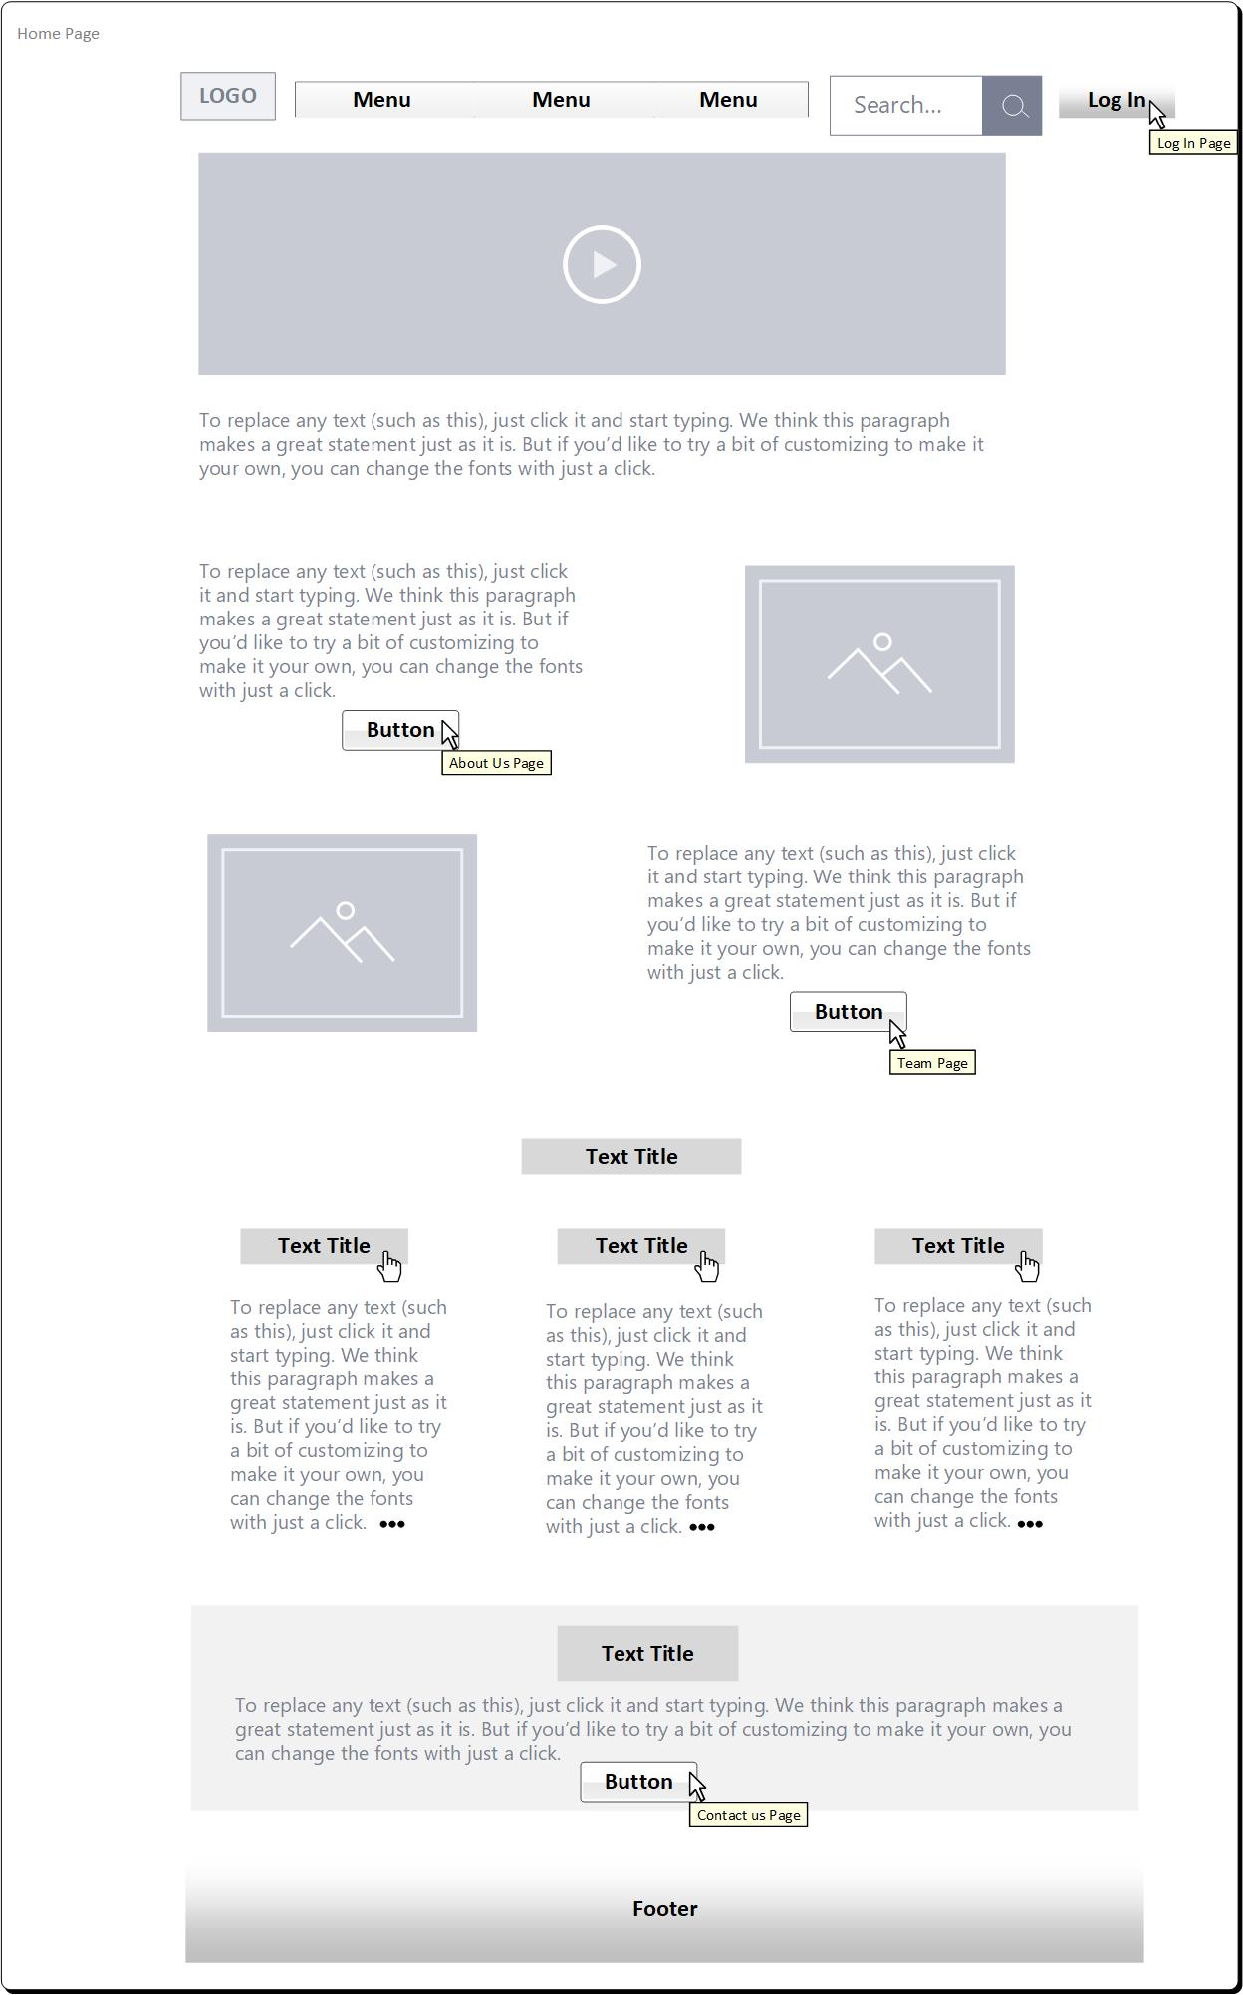
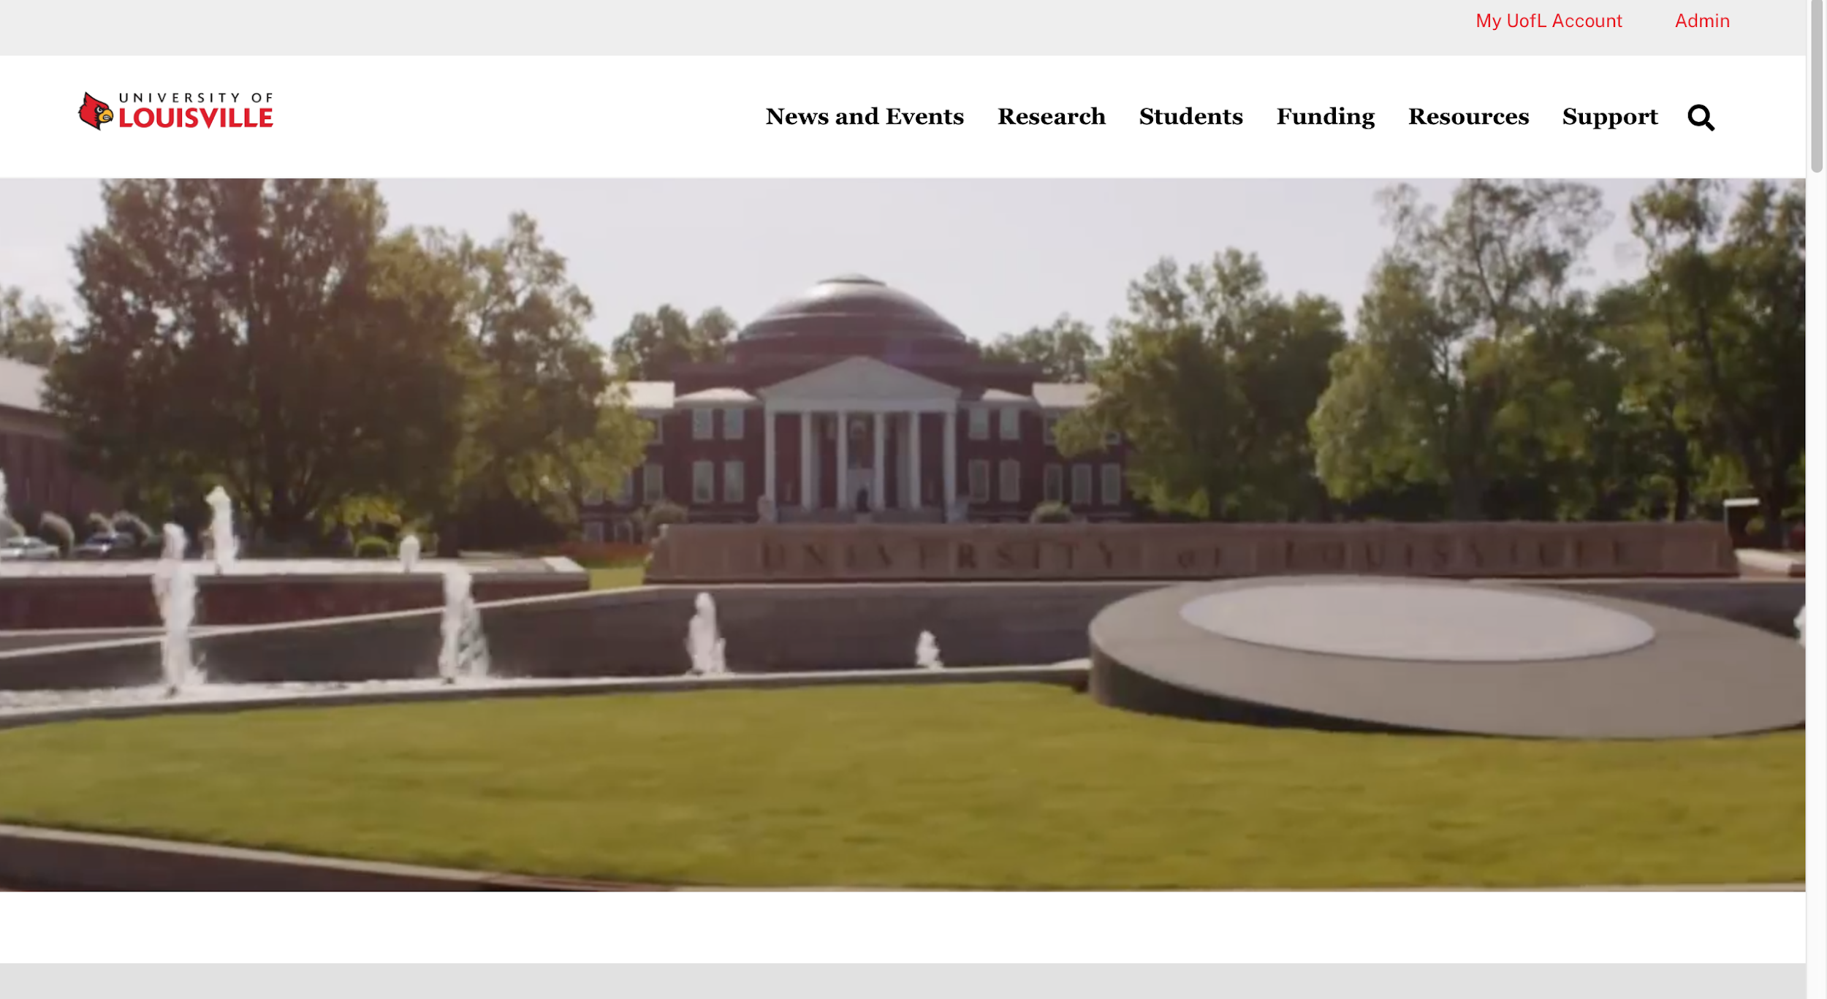
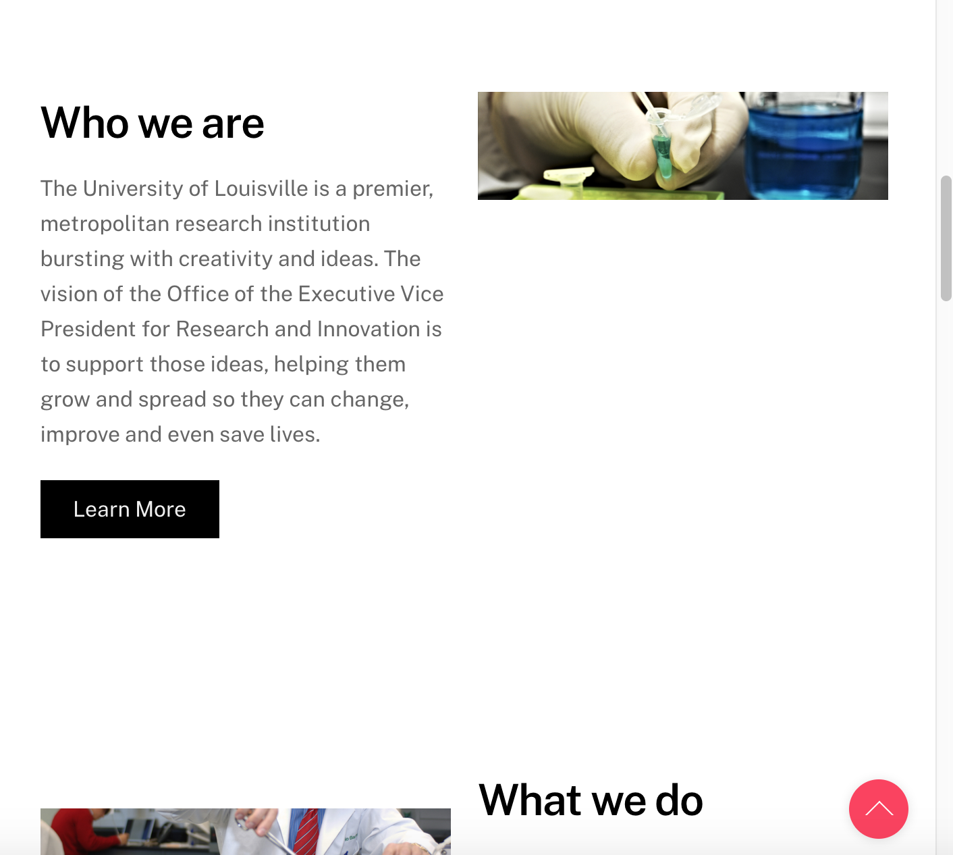
Home Page

Slide 5
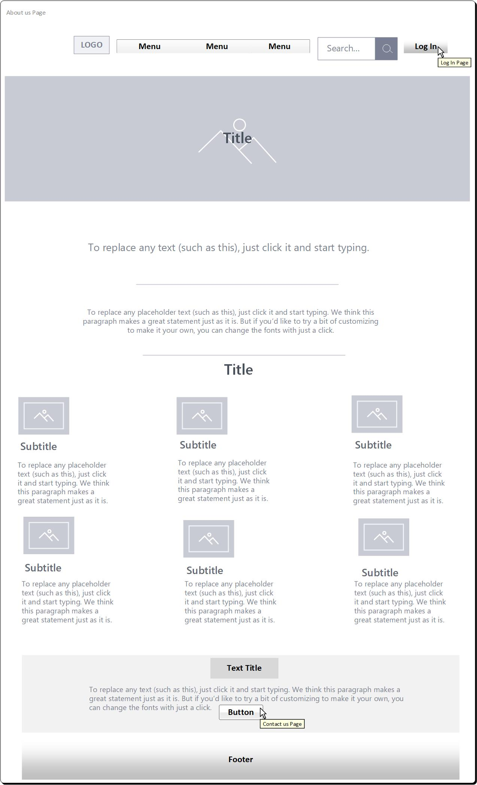
Research / About us

Slide 6
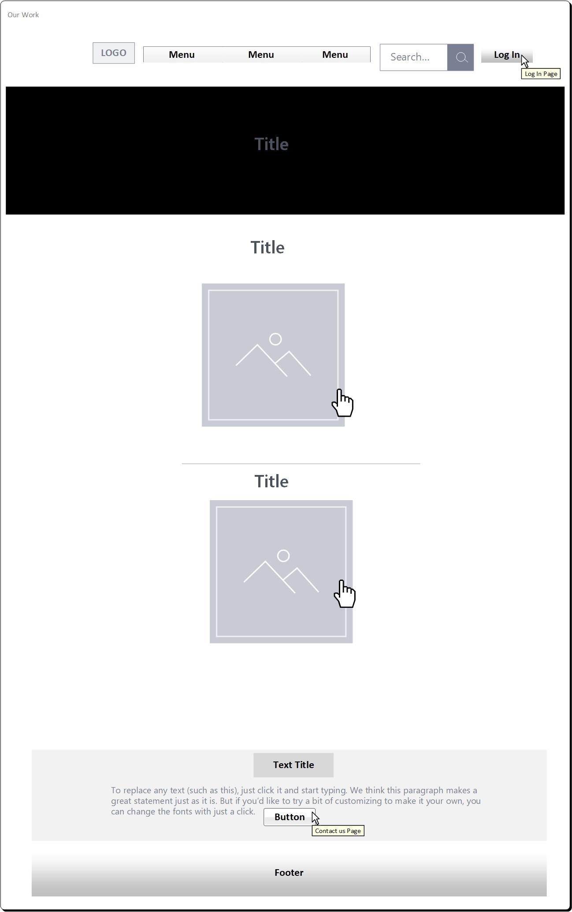
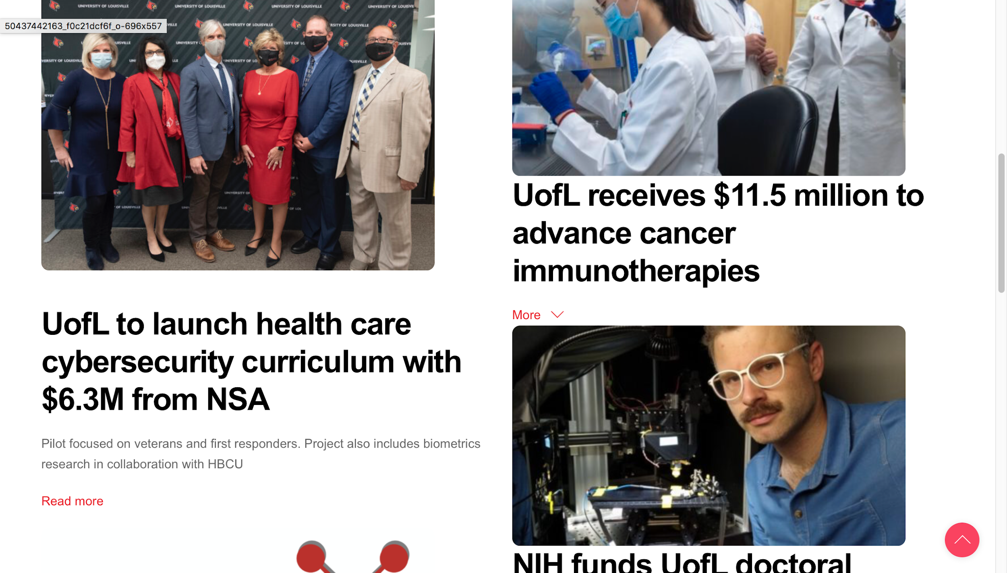
Our Work

Slide 7
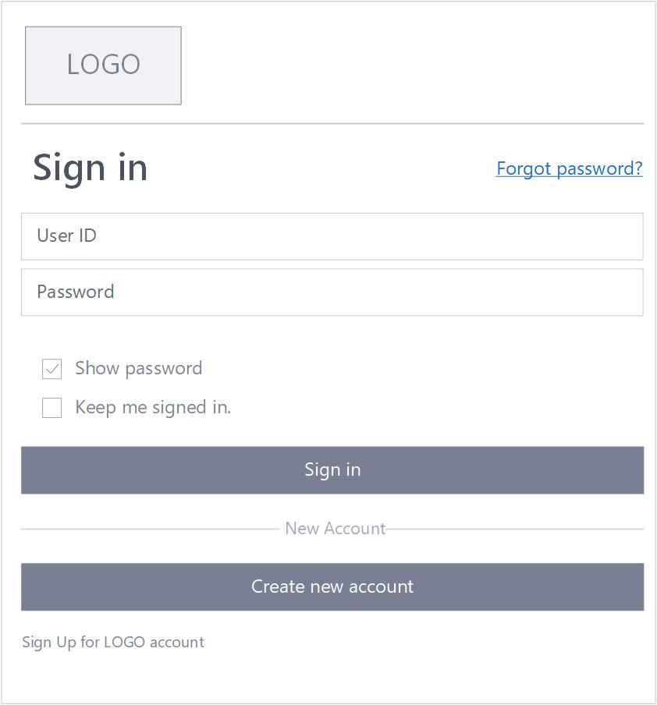
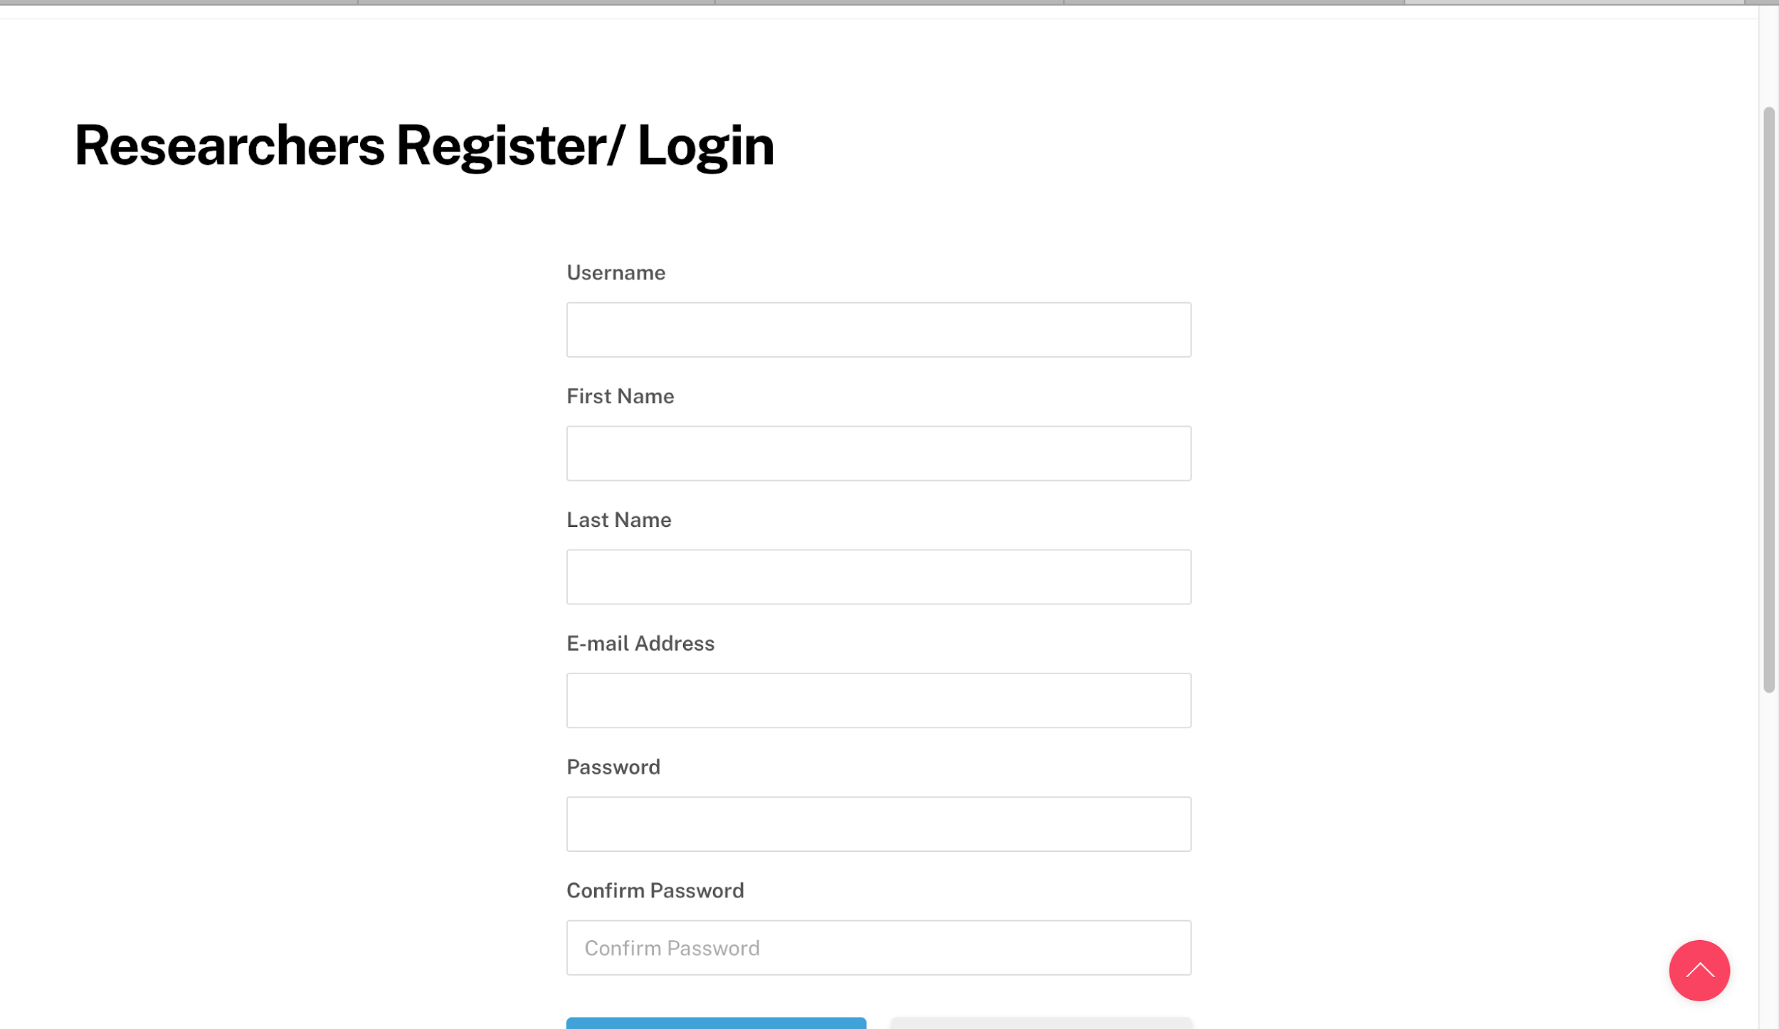
Log In

Slide 8
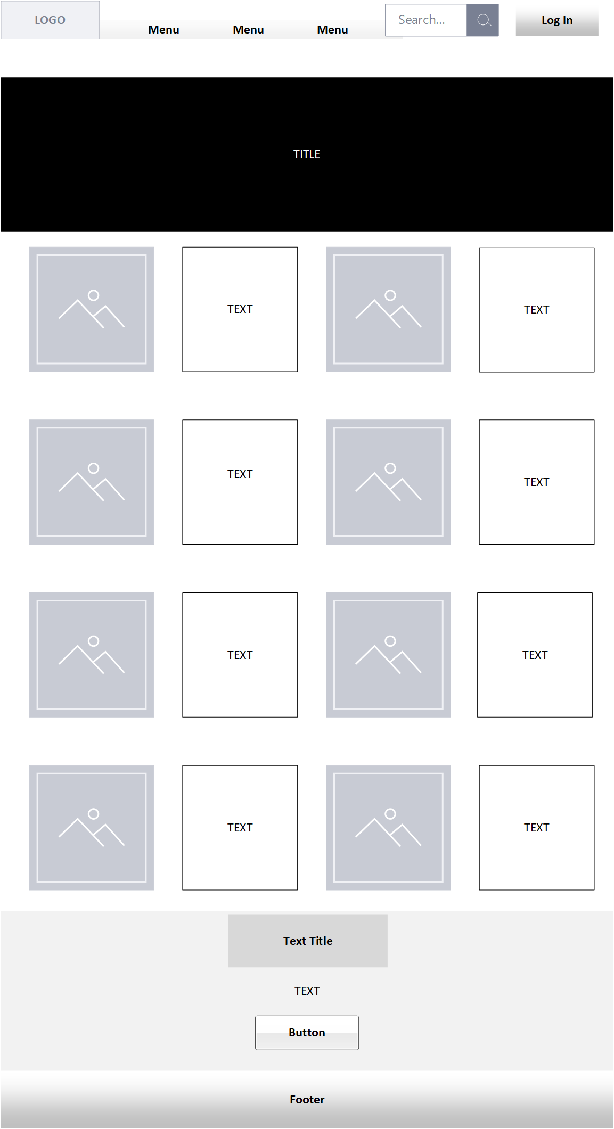
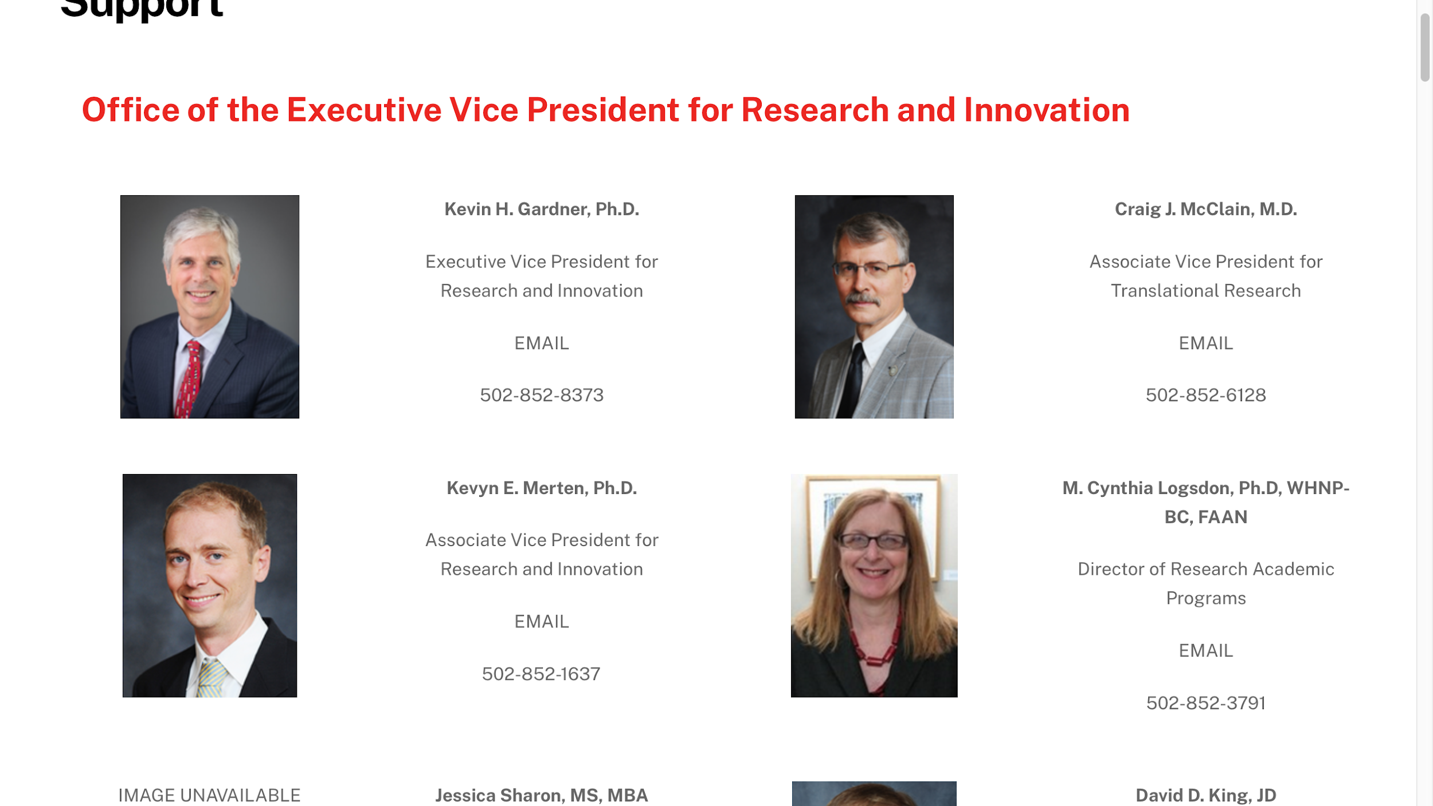
Support/Team

Slide 9
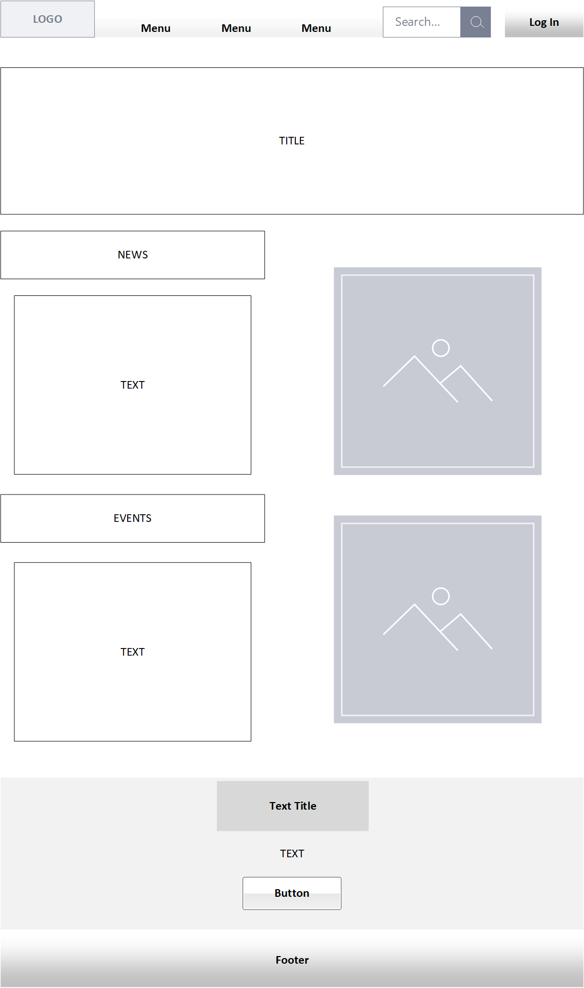
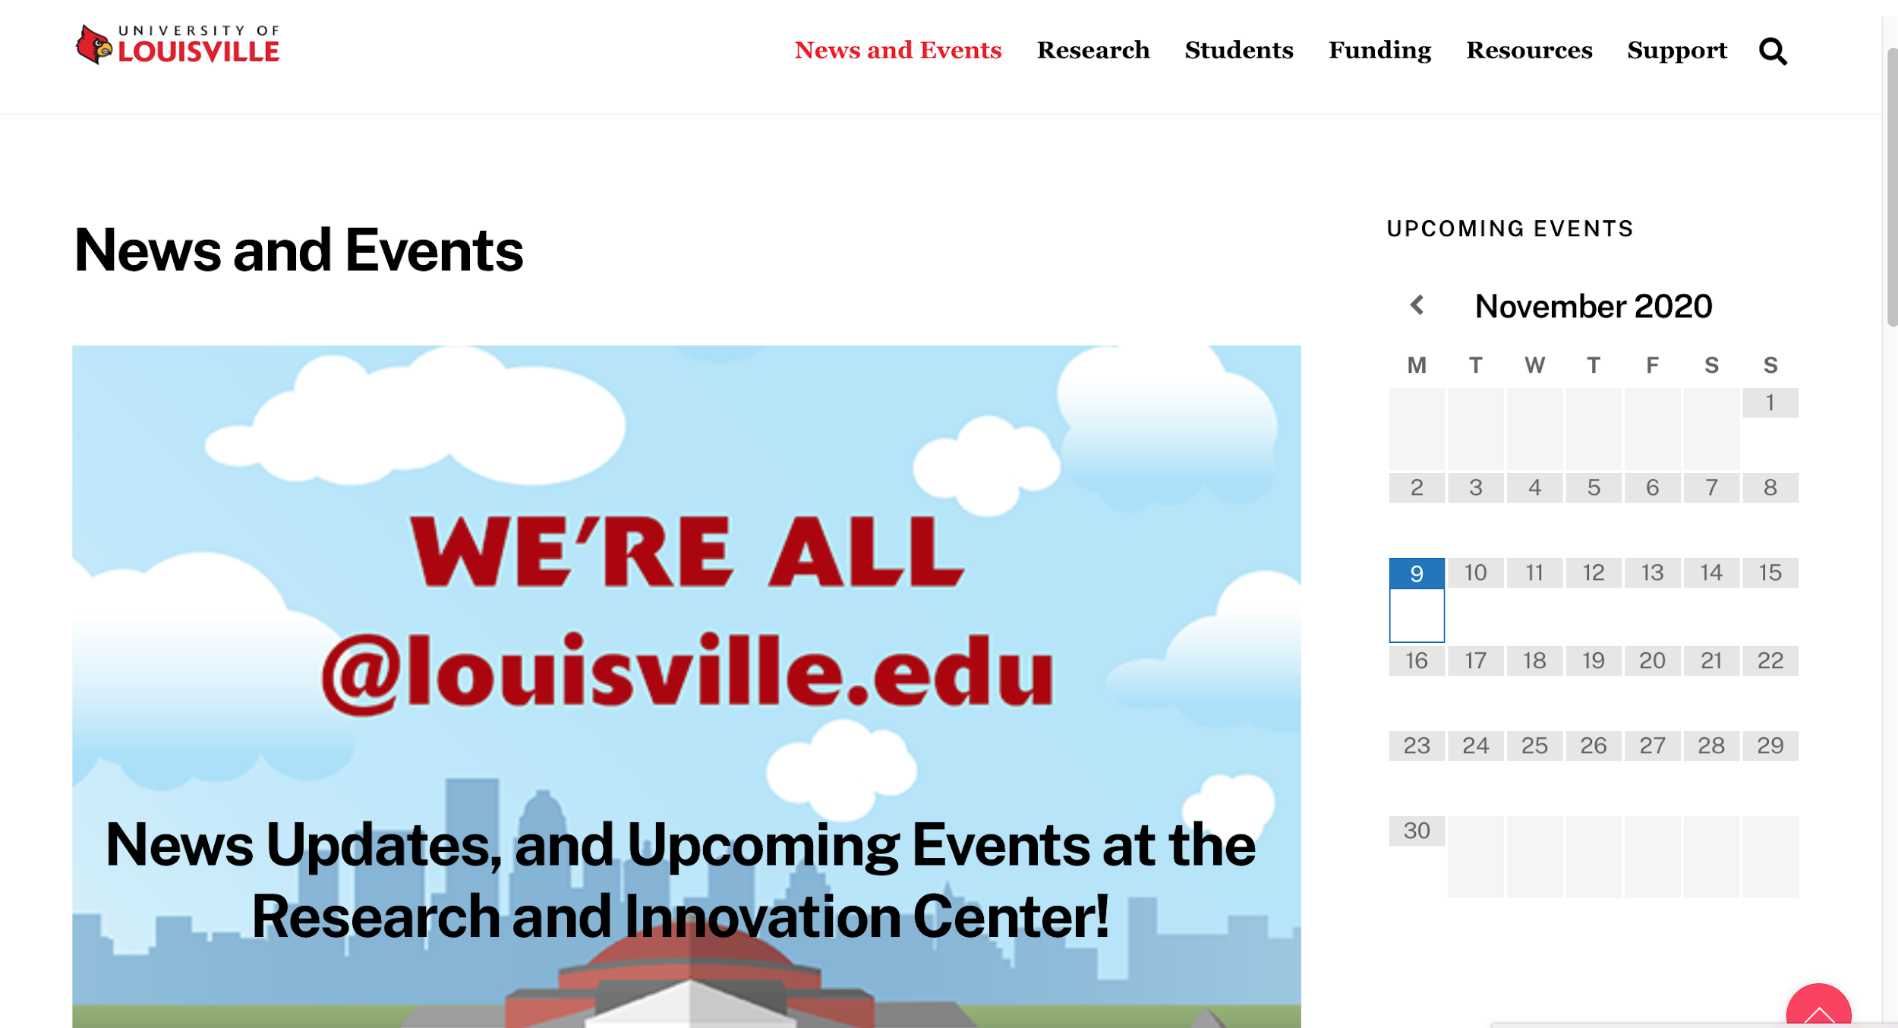
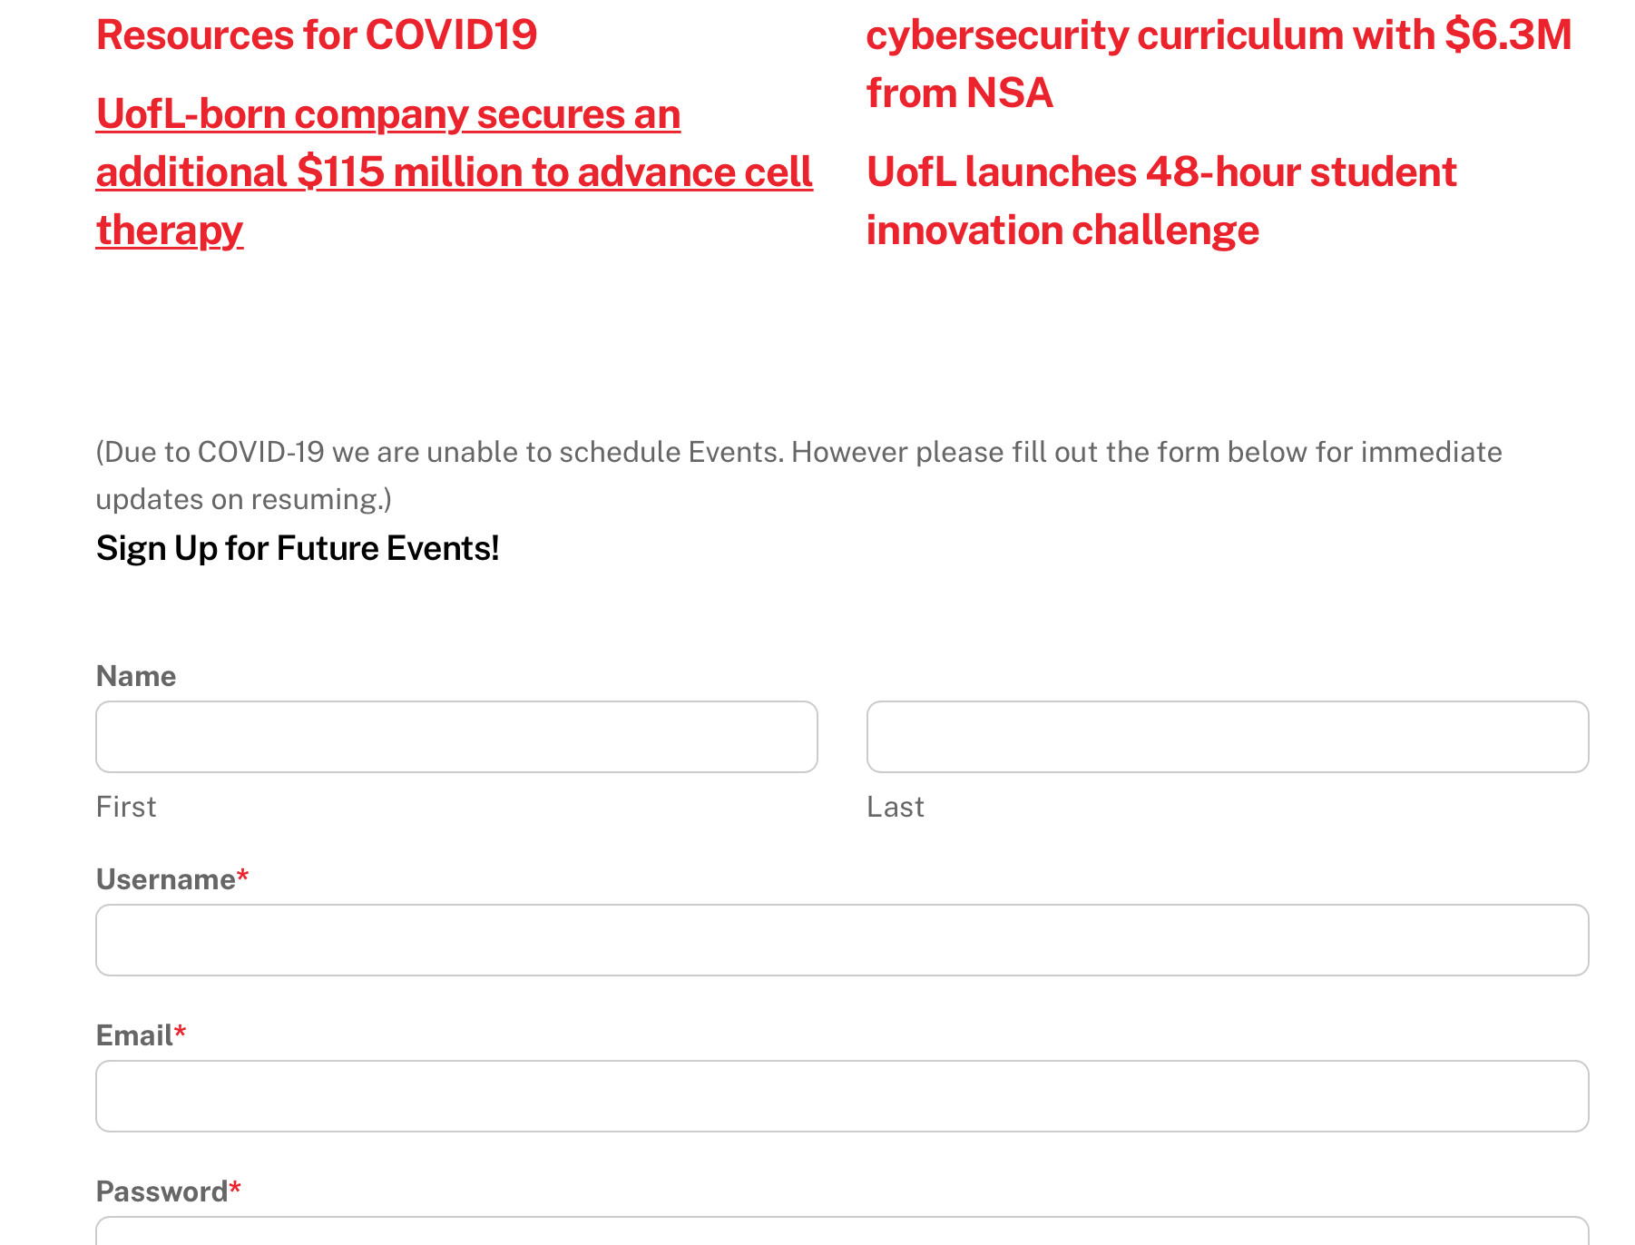
News and Events

Slide 10
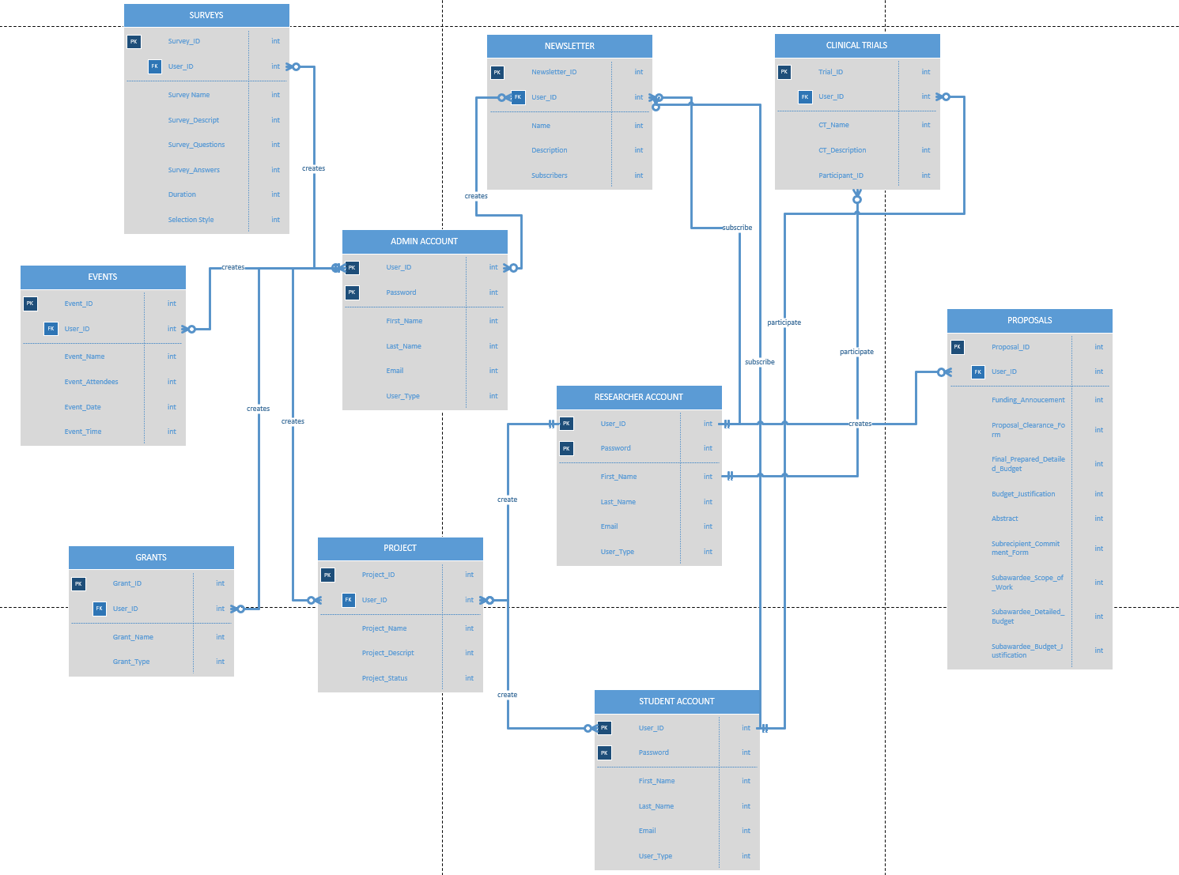
ERD
Notes:
We based our ERD on a combination of the Business Rules we created and the system requirements.
Each of our Entities comes from what we believe to be a major component of our project.
Such as each type of user having there own type of account like Student, Researcher, or Admin

Slide 11
Business Rules
Admin
Admin Account can apply for one or many Grants
Grants can be applied for by one or many Admin Accounts
Admin Accounts may create many or no Surveys
Surveys can be created by one or many Admin Accounts
Admin Accounts may edit many or no Surveys
Surveys can be edited by one or many Admin Accounts
Researcher
Researcher Account can be part of many or no Clinical Trials
Clinical Trials can have many or no Researcher Account
Researcher Account has many or no Projects
Projects are with one Researcher Account
Researcher Accounts can apply for one or many Grants
Grants can be applied for by one or many Researcher Accounts

Slide 12
Business Rules Cont.
Students
Student Account can be part of many or no Clinical Trials
Clinical Trials can have many or no Student Account
Student Accounts can apply for one or many Grants
Grants can be applied for by one or many Student Accounts
Student Account are associated with many or no Projects
Projects are associated with many or no Student Accounts

Slide 13
Software Tools Used
HostGator.com
Themify (Ultra theme)
Wordpress.org
Microsoft Visio
Ultimate Member Plugin

Slide 14
A live demo of your website:
UofLProject.com

